Slide 1
Overview. Data. Descriptive Statistics
Collecting, Organizing, Summarizing and Presenting data

Slide 2
1. Overview
Statistics can be defined in many different ways. Here are presented two of the most popular definitions:
Definition 1. Statistics is a collection of methods for planning experiments, obtaining data, and then organizing, summarizing, presenting, analyzing, interpreting and drawing conclusions based on data.
Definition 2. Statistics is a collection of methods that allow us to draw inferences about populations by analyzing samples of those populations.

Slide 3
Population
Definition: A population is the complete collection of all elements (scores, measurements, people, and so on) to be studied.
Ex. 1 A population is a number that can be known or unknown. For example, a population might be the population of cars parked at Centennial College.

Slide 4
Sample
Definition: A sample is a sub-collection of elements drawn from a population.
Ex. 2: A sample could be the cars parked in lot number 4 at Centennial College

Slide 5
Drawing inferences
A large part of statistics concerns drawing inference about populations from samples taken from that population.
For instance, if we would like to draw a conclusion about number of cars that are 2010 or newer models parked at Centennial College, we can randomly pick a sample of cars from the population of cars parked at the college.

Slide 6
Biased Sampling Method: A sampling method that produces data which systematically differs from the sampled population. An unbiased sampling method is one that is not biased.
Sampling methods that often result in biased samples:
1. Convenience sample: sample selected from elements of a
population that are easily accessible.
2. Volunteer sample: sample collected from those elements
of the population which chose to contribute the needed
information on their own initiative.

Slide 7
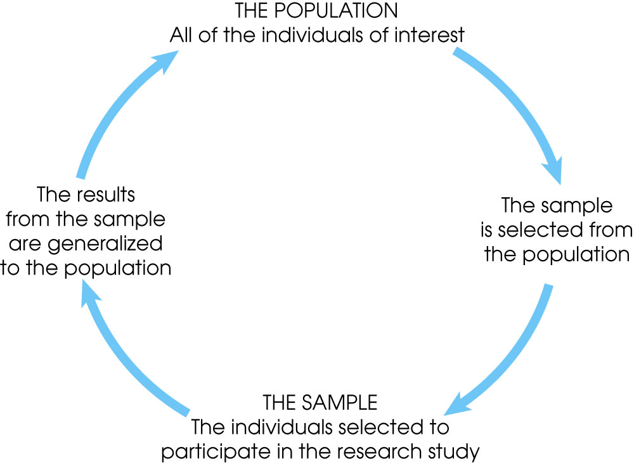
Notes:
Figure 1.1
The relationship between a population and a sample.

Slide 8
PARAMETERS AND STATISTICS
Definition. In statistics, a parameter is a measure pertaining to a population (describing a characteristic of a population).
Definition. A statistic is a measure pertaining to a sample (describing a characteristic of a sample).

Slide 9
MORE ABOUT PARAMETERS AND STATISTICS
An example of a characteristic is the mean or the average. The mean of a population represents a parameter while the mean of a sample from that population represents a statistic. We use the mean of the sample to estimate the mean of the population (as we will see later on).
Otherwise stated, a sample statistic, such as mean (average), is our best estimate of its associated population parameter.

Slide 10
2. The nature of data.
Firstly, we can distinguish between Quantitative data and Qualitative data.
Definition: Quantitative data is numerical (represents counts or measurements).
Definition: Qualitative data is categorical.
Ex.1: The temperature of Lake Ontario over the 3 months of summer is an example of quantitative data.
Ex. 2: The political affiliation of people living in Ontario: Conservative, Liberal, NDP, Green is an example qualitative data.

Slide 11
Discrete and Continuous Data
Definition. Discrete data results from either a finite number of possible values or a countable number of values.
Definition. Continuous data results from infinitely many possible values that can be associated with points on a continuous scale, in such a way that there are no gaps or interruptions.
In short, discrete data can be counted while continuous data cannot.
Ex. 1: The cars in a parking lot or the number of students in a course are examples of discrete data.
Ex. 2: The height of a child or the temperature during the day are examples of continuous data.

Slide 12
Descriptive Statistics. Frequency tables. Looking at an example
The manager of a car shop
would like to have a better
understanding of the cost
of parts used in the engine
repairs performed in the
shop. He examines 50
customer invoices for repairs. The cost of parts,
rounded to the nearest dollar, are listed on the next
slide.

Slide 13
Data collection - Cost of engine repair

Slide 14
Data organizing - Frequency table
Parts
Cost ($)
Parts
Frequency
Relative
Frequency(%)
2
13
16
7
7
5
50
4
26
32
14
14
10
100
50-59
60-69
70-79
80-89
90-99
100-109
(2/50)100

Slide 15
What statistical tools have the manager employed?
Collection of data
Organization of data
Summary of data
Presentation of data

Slide 16
Frequency tables
Frequency → number of times that an event takes place (happens)
The key here is that frequency is always about the NUMBER of times
Frequency table → a table that shows the frequencies of events

Slide 17
Frequency tables. Example
The number of calls from motorists per day for roadside service recorded for the month of December of a certain year by a CAA representative was as follows:
122 217 130 120 86 80 90 120 140
40 145 187 113 90 68 174 194 170
75 104 97 75 123 100 82 109 120
81
Set up a frequency table for this set of data values.

Slide 18
Steps
Order the data in ascending order.
Choose the number of classes for your frequency table (recommended number: between 5 and 20).
Determine the class width by dividing the range by the number of classes and round it up.
Select the first lower limit for the class the lowest value from the data or a convenient value slightly lower than the lowest data.
Add the class width to this lower limit to get the second lower limit, and so on.
List the lower and the upper limits on the left column of your table.
Count the values belonging to each class and enter them in the right column of your table.

Slide 19

Choose the number of classes: 5
Calculate the class width.
$w= \frac{H −L}{\# of classes}$ = $\frac{217 −28}{5}$

Slide 20
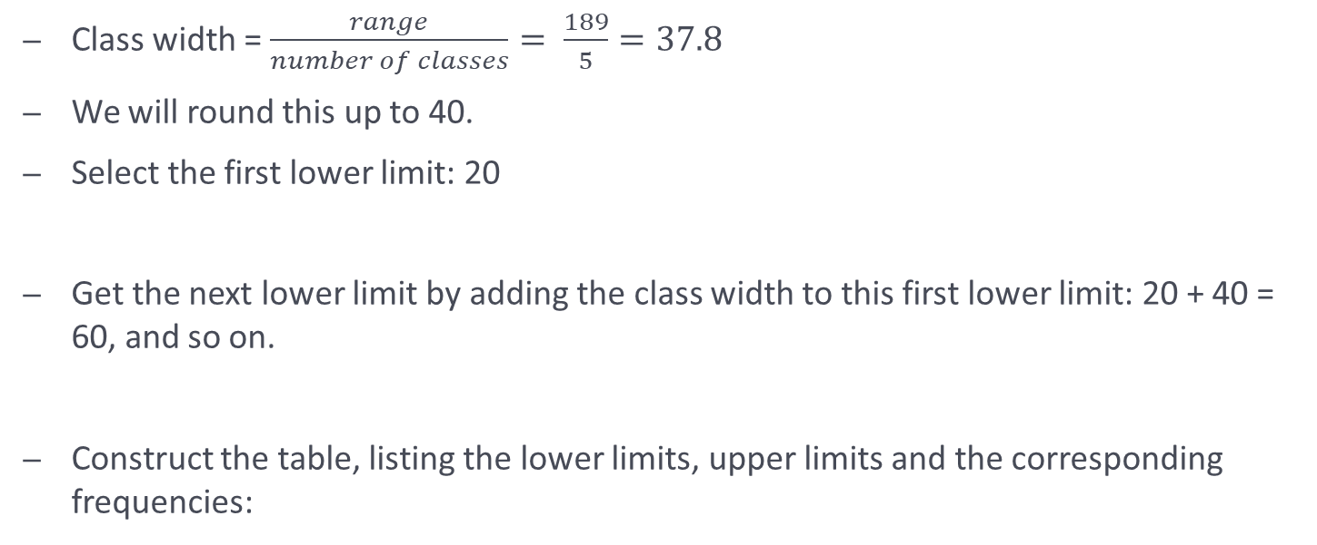
Class width = $\frac{range}{number of classes}= \frac{189}{5}=37.8$
We will round this up to 40.
Select the first lower limit: 20
Get the next lower limit by adding the class width to this first lower limit: 20 + 40 = 60, and so on.
Construct the table, listing the lower limits, upper limits and the corresponding frequencies:

Slide 21
Frequency table
Calls for roadside assistance - classes | Frequency
20-59 | 2
60-99 | 11
100-139 | 11
140-179 | 4
180-219 | 3

Slide 22
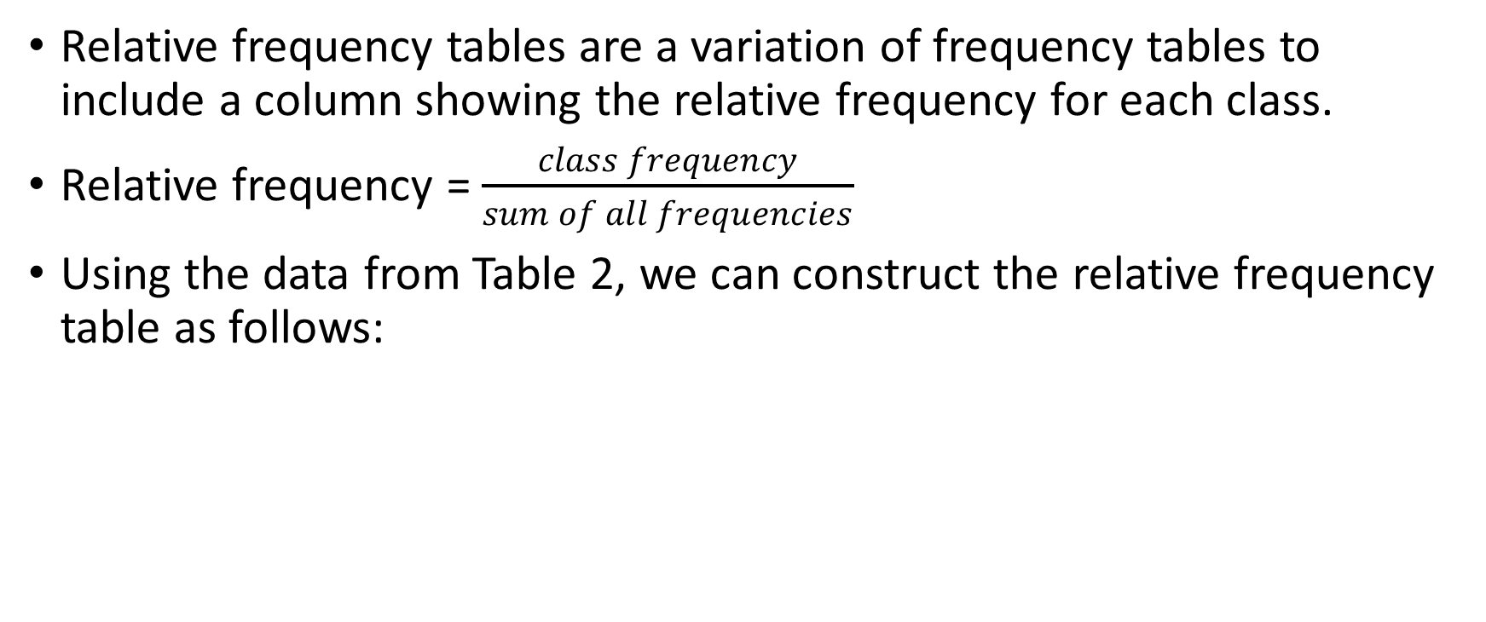
Relative frequency
Relative frequency tables are a variation of frequency tables to include a column showing the relative frequency for each class.
Relative frequency = $\frac{class frequency}{sum of all frequencies}$
Using the data from Table 2, we can construct the relative frequency table as follows:

Slide 23
Attention! The sum of relative frequencies should be 1 if you work with decimals and 100% if you work in percentages. Using fractions for the values of relative frequencies will ensure accuracy.
Calls for roadside assistance - classes | Relative frequency
20-59 | 2/31 = 0.0645
60-99 | 11/31=0.3549
100-139 | 11/31=0.3549
140-179 | 4/31=0.1290
180-219 | 3/31=0.0967
Total | 1

Slide 24
Cumulative relative frequency
The cumulative relative frequency for each class is the sum between the relative frequency of that class and all relative frequencies of the previous classes. This means, the last cumulative frequency should be 1 or 100%.

Slide 25
Histograms
4 1 10 5 2 2 1 1 9 1
7 0 2 3 3 1 0 4 8 4
Assume the following data represents the number of goals per game a football player has scored during a season.
Organize and present the data.

Slide 26
Class boundaries
A histogram uses class boundaries on the horizontal axis and frequencies on the vertical axis.
In order to determine the class boundaries:
A) Subtract an upper class limit from the next lower class limit and divide the result by 2
B) Add this number to each upper class limit and subtract it from each lower class limit. The results are the class boundaries.

Slide 27
Start with a frequency table
Number of goal per game (classes) | Class boundaries | Frequency | Midpoints
0 - 1 | 0 – 1.5 | 7 | 0.5
2 - 3 | 1.5 – 3.5 | 5 | 2.5
4 - 5 | 3.5 – 5.5 | 4 | 4.5
6 - 7 | 5.5 – 7.5 | 1 | 6.5
8 - 9 | 7.5 – 9.5 | 2 | 8.5
10 - 11 | 9.5 – 11.5 | 1 | 10.5

Slide 28
Present the data with a graph - Histogram
Frequency
Histogram of frequencies for the number of goals per game for player A
5
0 1.5 3.5 5.5 7.5 9.5 11.5 Number of goals per game

Slide 29
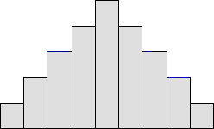
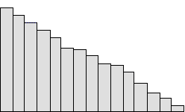
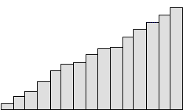
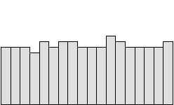
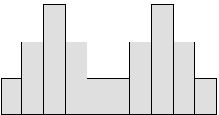
Some common shapes of histograms
Bell shaped (normal) Skewed to the right
Skewed to the left Uniform Bimodal

Slide 30
Other graphs…
X
X
X
Dot plot
X
X
X
X
X
X
X
X
X
X
X
X
X
X
X
X
X
0 1 2 3 4 5 6 7 8 9 10

Slide 31
Stem and leaf plot
Given the following data, construct a stem and leaf plot:
42 36 40 31 29 49 21 28 52 27 22 35 30 46 34 34
First order the data to create an ordered stem and leaf plot.

Slide 32
Stem and leaf plot:
Stems
Leaves
2 1 2 7 8 9
3 0 1 4 4 5 6
4 0 2 6 9
5 2
Key: 3 | 0 means 30

Slide 33
Comments
Leaves can have only one digit
Stems can have any number of digits
Data can be ordered resulting in an ordered stem and leaf plot

Slide 34
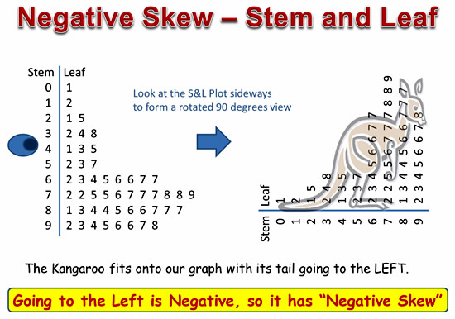
The stem and leaf plot shows the shape of the distribution

Slide 35
Pie charts Given the following data, construct a pie chart.
Job sources of survey respondents | Frequency
Help-wanted adds | 56
Executive search firms | 44
Networking | 280
Mass mailing | 20

Slide 36
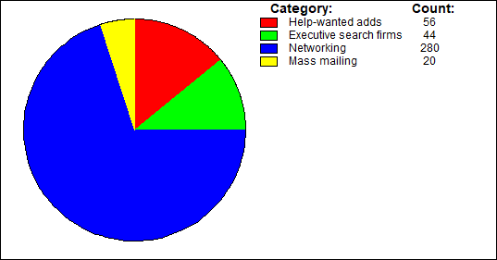

Slide 37
Scatterplots
- A scatterplot is a graph used to represent a relationship between two variables.
Researchers look for positive linear relationships when the data points increase from left to right; negative linear relationships when the data points decrease from left to right; non-linear relationships, or no relationship at all when the scatter shows no pattern, line or curve.

Slide 38
Types of relationships depicted by scatterplots

Slide 39
Construct a scatter plot for the data obtained in a study on the number of absences and the final grades of seven randomly selected students from a statistics class.
Student | Number of absences, x | Final grade, y (%)
A | 6 | 82
B | 2 | 86
C | 15 | 43
D | 9 | 74
E | 12 | 58
F | 5 | 90
G | 8 | 78

Slide 40
Step 1 Draw and label the x and y axes. Label in relation to size of variables. Step 2 Plot each point on the graph. Step 3 Determine the type of relationship, if any, that exists. (Negative linear relationship)

Slide 41
Practice 1. The table below shows a frequency distribution that is incorrectly constructed. State the reasons why it is wrong.
Class | Frequency
10–19 | 1
20–29 | 2
30–34 | 0
35–45 | 5
46–51 | 8

Slide 42
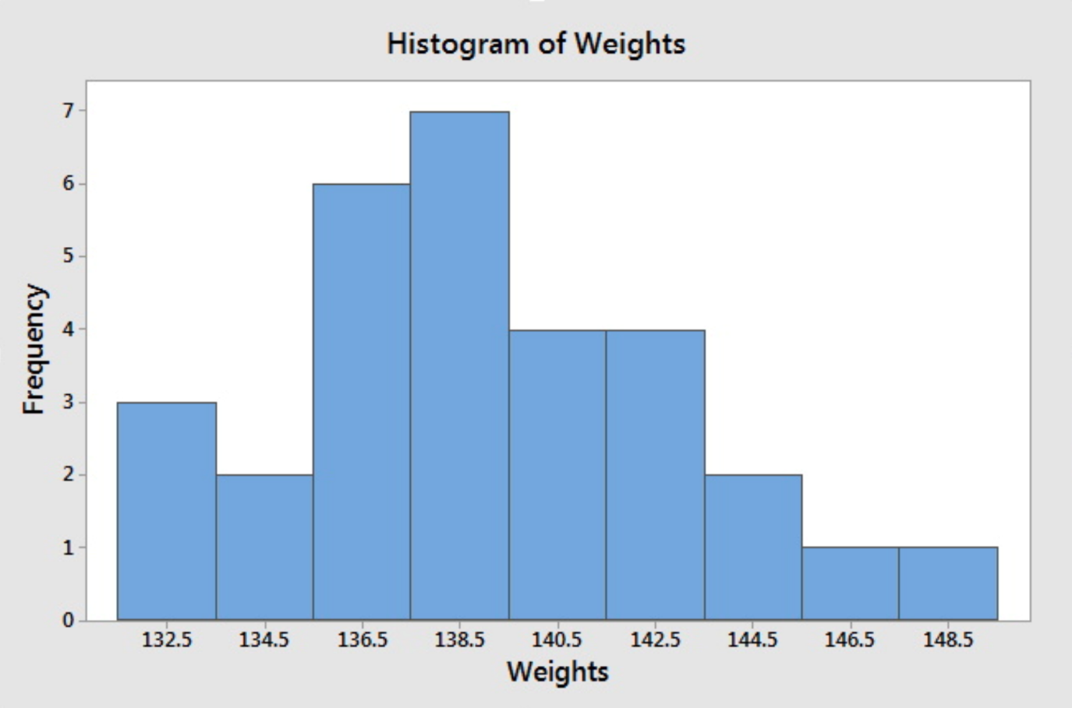
2. Given the histogram below, where on the horizontal axis, the midpoints are indicated, find: a) How many values were recorded?; b) What are the class boundaries for the second class? c) What is the relative frequency for the 5th class? d) What is the shape (tendency) of data?

Slide 44
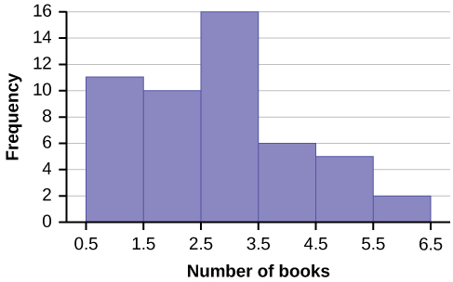
3. Given the histogram below, representing the frequencies for the number of books read by students in an English class, find: a) the class width b) The relative frequency of class 6. c) The cumulative relative frequency of class 2.

Slide 45
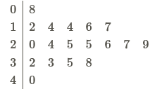
4. The following stem and leaf plot represents the height of wild flowers in a certain area. The key is: 1I2 represents 1.2 inches. Find:
A) How many heights have been recorded?
B) How many flowers have heights equal to or above 3.2 inches?
C) What is the shape of the distribution?

